Slide 1



Mercadona’s supply chain
Optimizing the delivery routes

Slide 2
Introduction
AI methods to identify the most efficient routes
Improve Mercadona’s supply chain efficiency
The project would contribute to Mercadona’s sustainability efforts

Slide 3
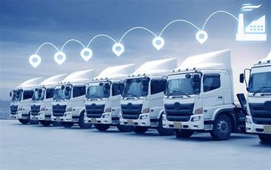
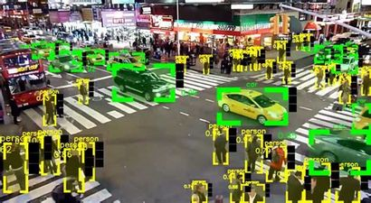



Data source
Structured data
Semi-structured data
Unstructured data
Data ingestion
Batch processing
Stream processing

Slide 4




Data Storage
On-premises storage
Cloud storage
Method used
Machine learning algorithm
- Genetic algorith
- simulated annealing algorithm

Slide 5
Personnel required
Data Scientist
AI developers
Business Analysts
Project Manager

Slide 6
Business functions
Sales
Operations
IT
Finance

